Slide 1
Corpora terminology dictionary
Joanna Bilińska
Warsaw, Poland

Slide 2
Institute of Western ans Southern Slavic Studies, University of Warsaw
interests:
  linguistics,
  lexicography,
  retrodigitisation,
  Slovene

Slide 3
Previous work
investigation of the 19th century multilingual Linde’s dictionary of Polish (S. B. Linde. Dictionary of Polish. Lviv 1854-1861)
description of macro- and microstructure for retrodigitisation purposes.

Slide 4
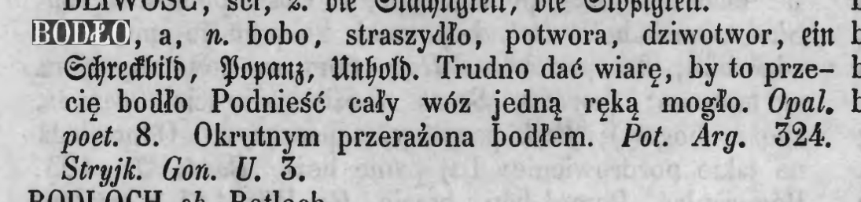
Sample entry

Slide 5
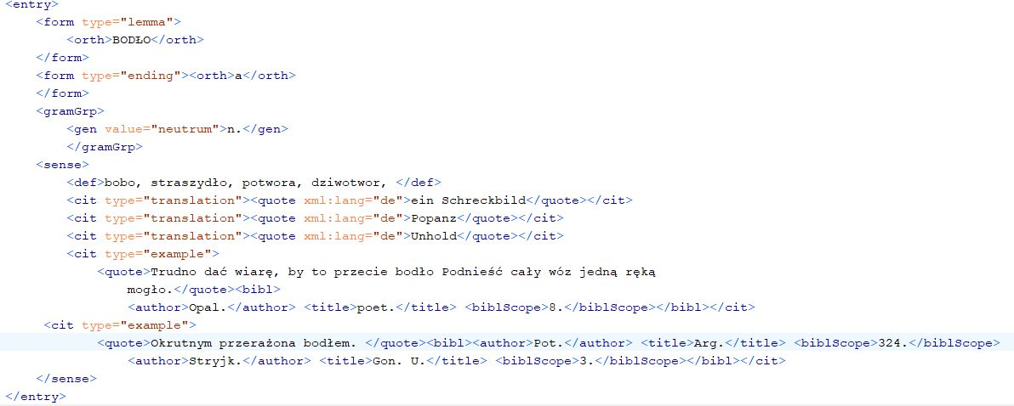
Sample entry in TEI

Slide 6
indices for the dictionary
an algorithm for identifying foreign languages parts within dictionary entries
Slovene lexical data included in the dictionary analysis

Slide 7
Project: Corpora terminology
2018, beginning of the project,
corpora terminology in Slavic languages - comparison
team: Milena Hebal-Jezierska, Iliana Genew-Puhalewa, Joanna Bilińska, Monika Siedlecka, Ida Dudek and others

Slide 8
Languages
Bulgarian,
Czech,
Slovene,
Polish,
(English),
more to be added

Slide 9
Dictionary preparation
separate file for every language
TEI
link between languages
digitally born
most of the team members – no TEI knowledge, work in Notepad++

Slide 10
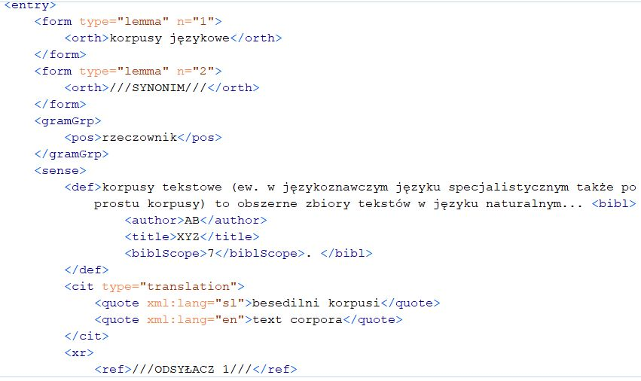

Slide 11
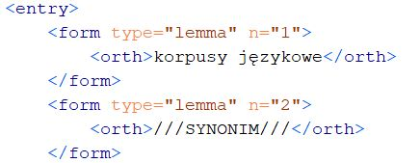
Problems

Slide 12
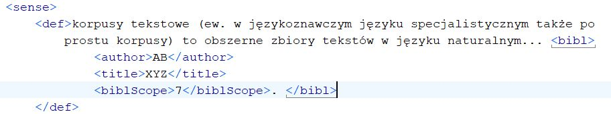
Bibliographic information

Slide 13
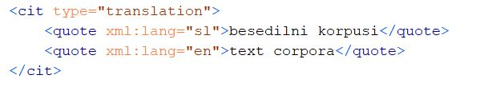
Translations

Slide 14
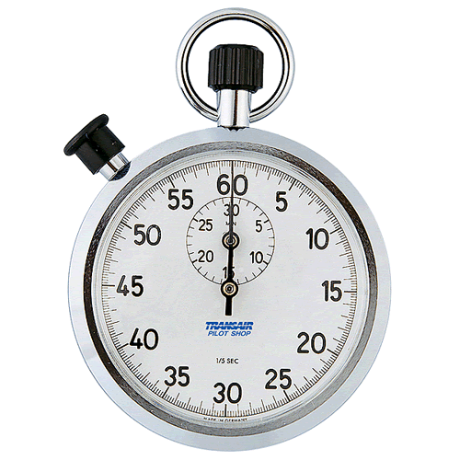
Time’s Up!
About your speaker:
  Name: Joanna Bilińska
  Institution: Institute of Western and Southern Slavic Studies, University of Warsaw
  Social Media: https://www.facebook.com/joanna.bilinska
  https://sites.google.com/site/joannabilinska/
  Quick bio: studied Polish Studies, then Slavic Studies,University of Warsaw; PhD in linguistics; linguistics works for Polish National Corpus, 19th century Polish Corpus, Słowosieć (WordNetPl), Multisłownik

